Slide 1
Module-3
Image Restoration

Slide 2
Image Restoration
Image restoration aim to improve an image insome predefined sense.
Restoration tries to recover / restore degraded image by using a prior knowledge of the degradation phenomenon.
Restoration techniques focuses on:
  Modeling the degradation
  Applying inverse process in order to recover the original image.

Slide 3
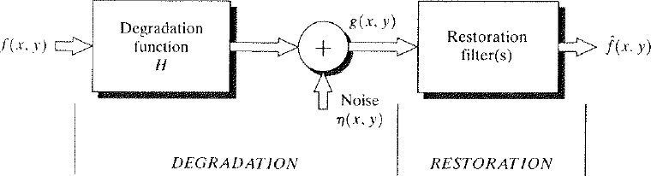
Model of the Image Degradation / Restoration Process
Degradation function along with some additive noise operates on f(x, y) to produce degraded image g(x, y).
Given g(x, y), some knowledge about the degradation function H and additive noise η(x, y), objective of restoration is to obtain estimate f’(x, y) of the original image.

Slide 4
Model of the Image Degradation
If H is linear, position invariant process then degraded image in
spatial domain is given by:
h(x, y) = Spatial representation of H.
* indicates convolution.
Since convolution in Spatial domain = multiplication in Frequency Domain
We Assume that H is identity operator and deal only with degradation due to Noise.

Slide 5
Noise Models
Noise in digital image arises during - Image Acquisition and Transmission.
During Image Acquisition
  due to Environmental conditions (Light Levels)
  Quality of sensing element.
During Transmission due to Interference.

Slide 6
Properties of Noise
Spatial Properties of Noise
  With few exception we consider that noise is independent of spatial coordinates.
  We assume that noise is uncorrelated with respect to the image itself (There is no correlation between image pixels and the values of noise components).
  Fourier Properties of Noise
  Refers to the frequency contents of noise in the Fourier sense.
  If Fourier spectrum of noise is Constant, the noise is usually called WHITE NOISE

Slide 7
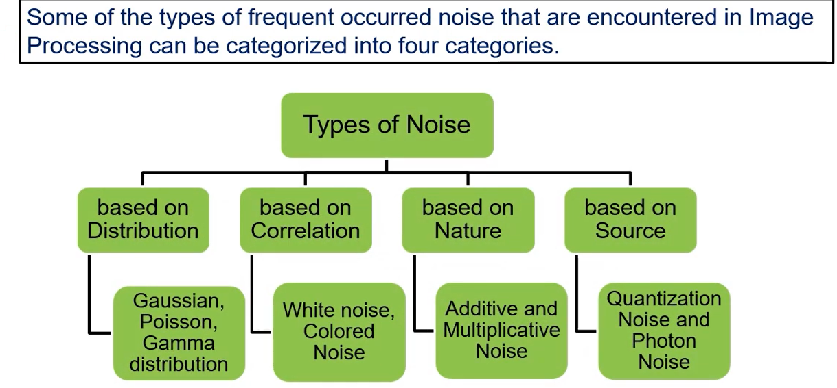

Slide 8
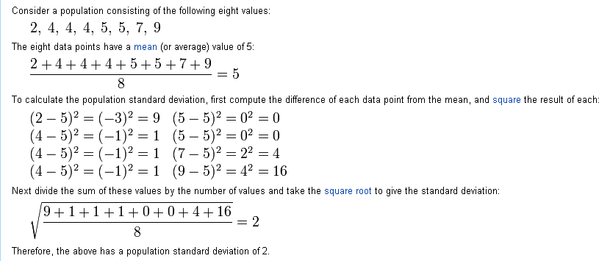
Spatial Noise Descriptor
Statistical behavior of the gray level values in the noise component.
Can be considered as random variables Characterized by Probability Density Functions (PDFs).

Slide 9
Some Noise Probability Density Functions (PDFs):
Gaussian Noise
Rayleigh Noise
Erlang (Gamma) Noise
Exponential Noise
Uniform Noise
Impulse (Sal & Pepper Noise)
Periodic Noise

Slide 10

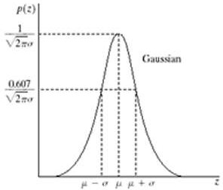
Gaussian / Normal Noise Model
Most frequently used.
PDF of Gaussian random variable z is given by:
  z → Gray level
  µ → Mean of average value of z
  σ → Standard Deviation of z
  σ² → Variance of z
When z is defined by this equation then
About 70% of its values will be in the range [(µ - σ),(µ + σ)] and
About 95% of its values will be in the
range [(µ - 2σ),(µ + 2σ)]
Plot of function

Slide 11


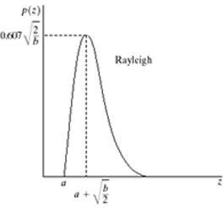

Rayleigh Noise Model
PDF of Rayleigh Noise is given by:
z → Gray level
µ → Mean of average value of z
σ² → Variance of z
Basic shape of this density is skewed to
the right.
Quite useful for approximating skewed histograms.
Plot of function

Slide 12



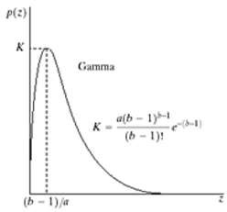
Erlang (Gamma) Noise Model
PDF of Erlang Noise is given by:
z → Gray level
µ → Mean of average value of z
σ² → Variance of z
a > 0
b = positive integer
Above equation is also called
Erlang Density
If denominator is Gamma function then it is called Gamma density
Plot of function

Slide 13


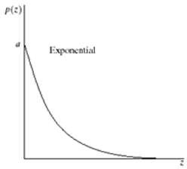

Exponential Noise Model
PDF of Exponential Noise is given by:
z → Gray level
µ → Mean of average value of z
σ² → Variance of z
a > 0
Special case of Erlang Density
Where b=1
Plot of function

Slide 14


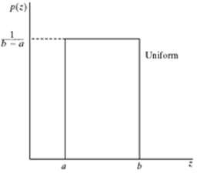

Uniform Noise Model
PDF of Uniform Noise is given by:
z → Gray level
µ → Mean of average value of z
σ² → Variance of z
Plot of function

Slide 15

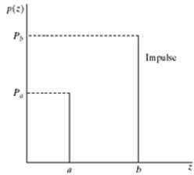
Impulse (Salt & Pepper) Noise Model
PDF of Uniform Noise is given by:
z → Gray level
If b > a then b → light dot and a→ dark
dot
If either P_{a} or P_{b}
= 0 → Unipolar
Impulse Noise otherwise Bipolar
Impulse Noise.
If Neither probability is 0 and approximately equal then noise values will resemble salt & pepper granules randomly distributed over the image.
Also referred as Shot and Spike Noise

Slide 16
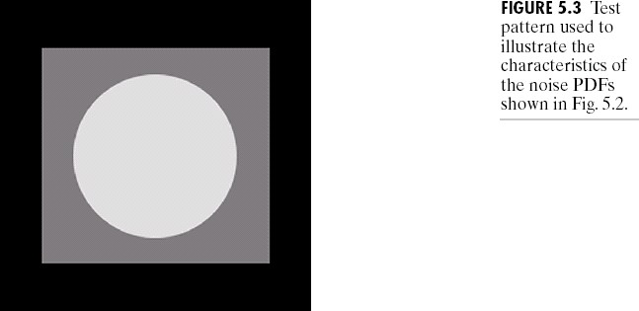
Example
This test pattern is well-suited for illustrating the noise models, because it is composed of simple, constant areas that span the grey scale from black to white in only three increments. This facilitates visual analysis of the characteristics of the various noise components added to the image.

Slide 17
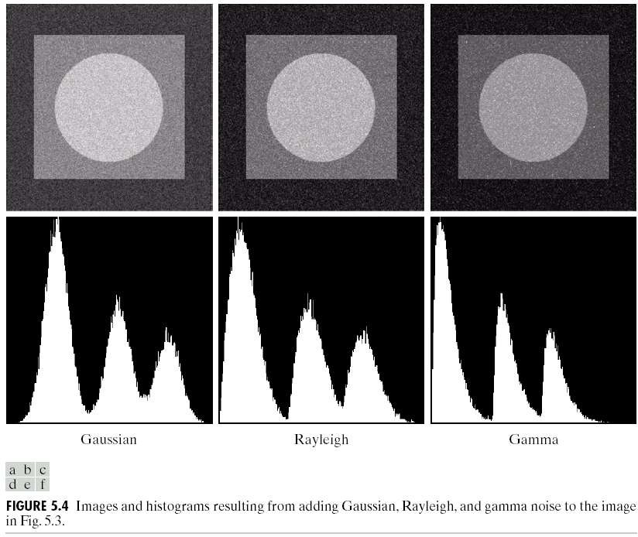

Slide 18
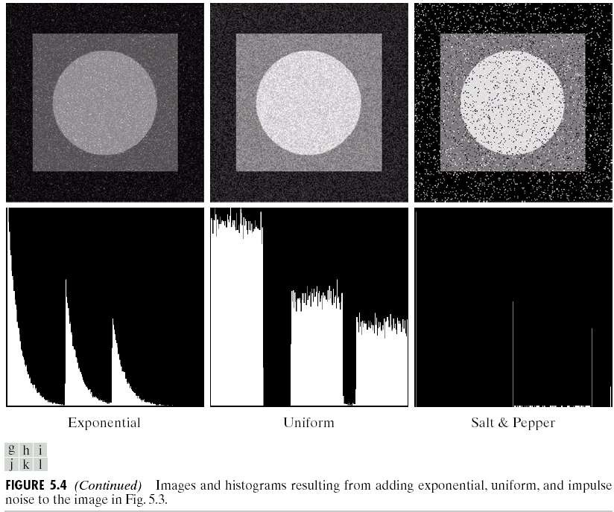

Slide 19
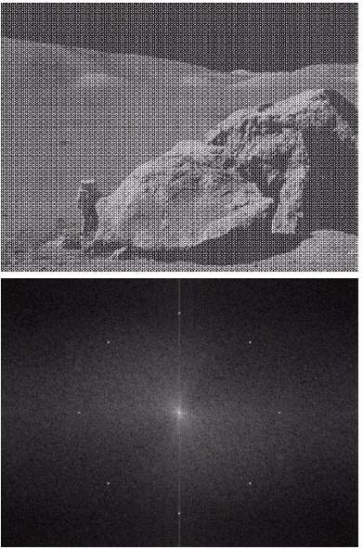
Periodic Noise
Image corrupted by Sinusoidal noise
Typically arises due to electrical / Electro- mechanical interference during image acquisition.
Spatially dependent noise.
Can be reduced significantly via Frequency Domain Filtering.
Parameters can be estimated by inspecting the Frequency Spectrum of the image.
Periodic noise tend to produce frequency spikes
Spectrum (Each pair of conjugate impulses corresponds to one sine wave)

